Slide 1

Tensorflow Implementation of (Auto) Gradient Descent

Slide 2
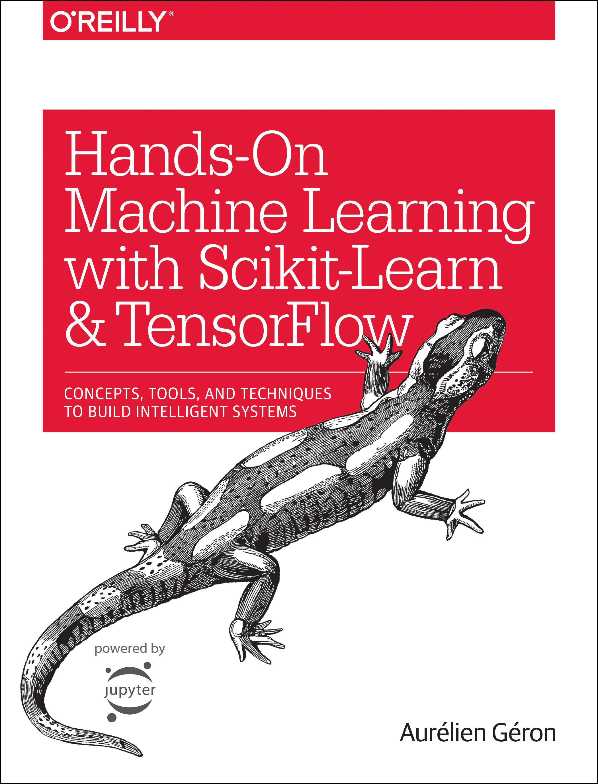
Reference
Chapter 9 (O'Reilly) of Hands-On ML
Youtube on Gradient Computation
Youtube on (Manual) Gradient Descent
Youtube
Code

Slide 3
Data

Slide 4
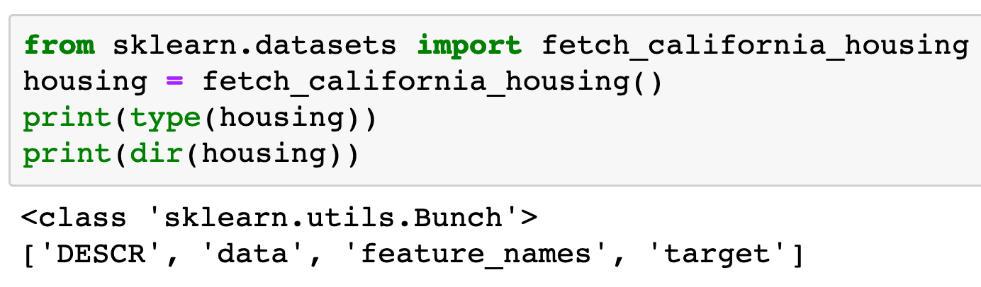

Slide 5
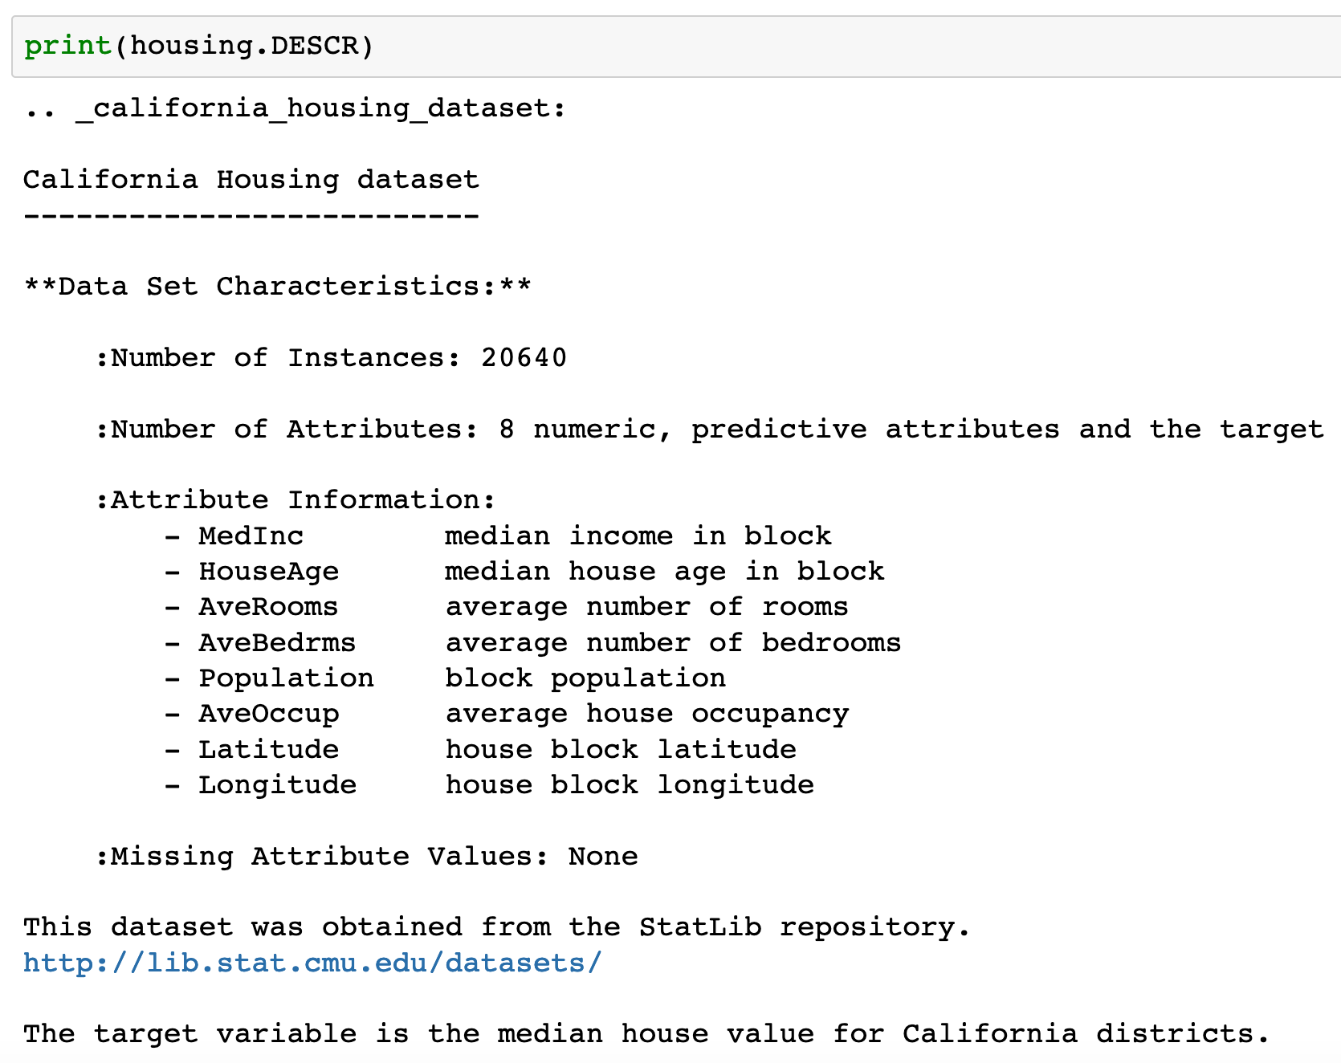

Slide 6
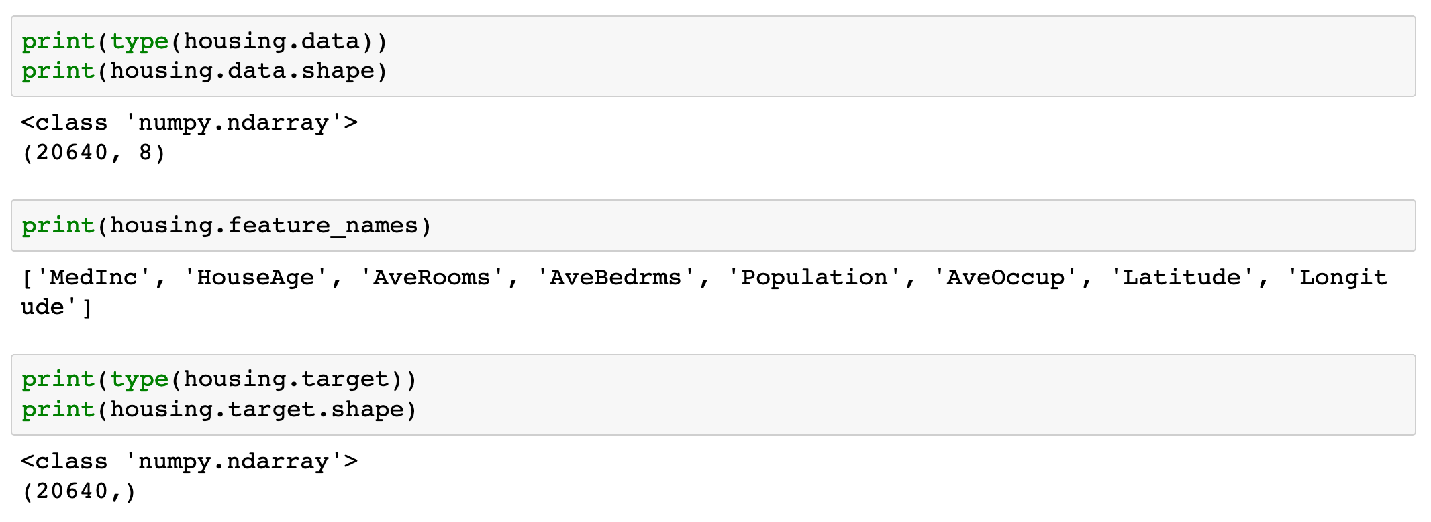

Slide 7
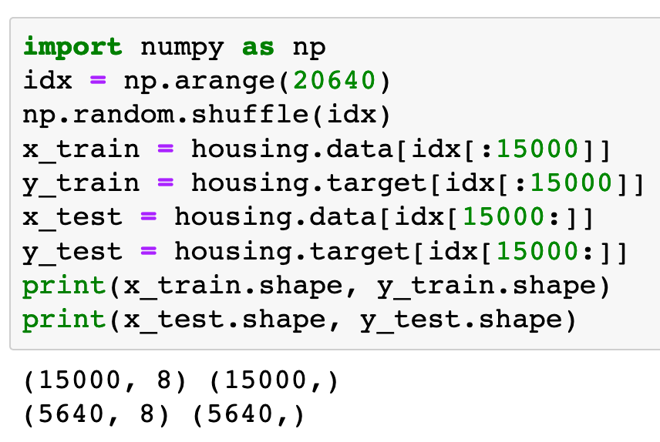

Slide 8
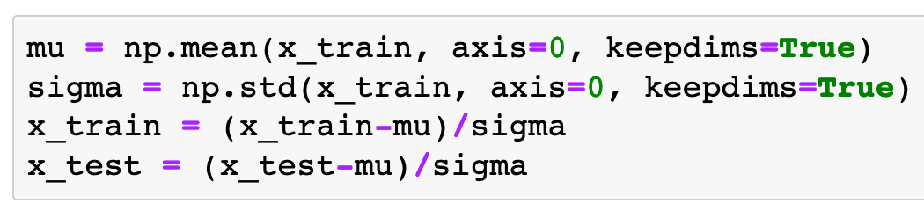
Input Normalization

Slide 9
Warm Up

Slide 10
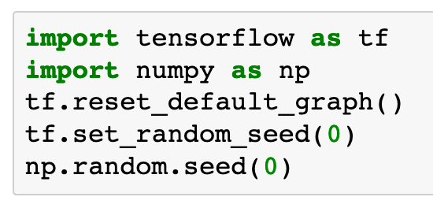

Slide 11
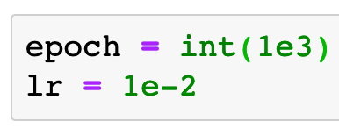

Slide 12
Graph

Slide 13
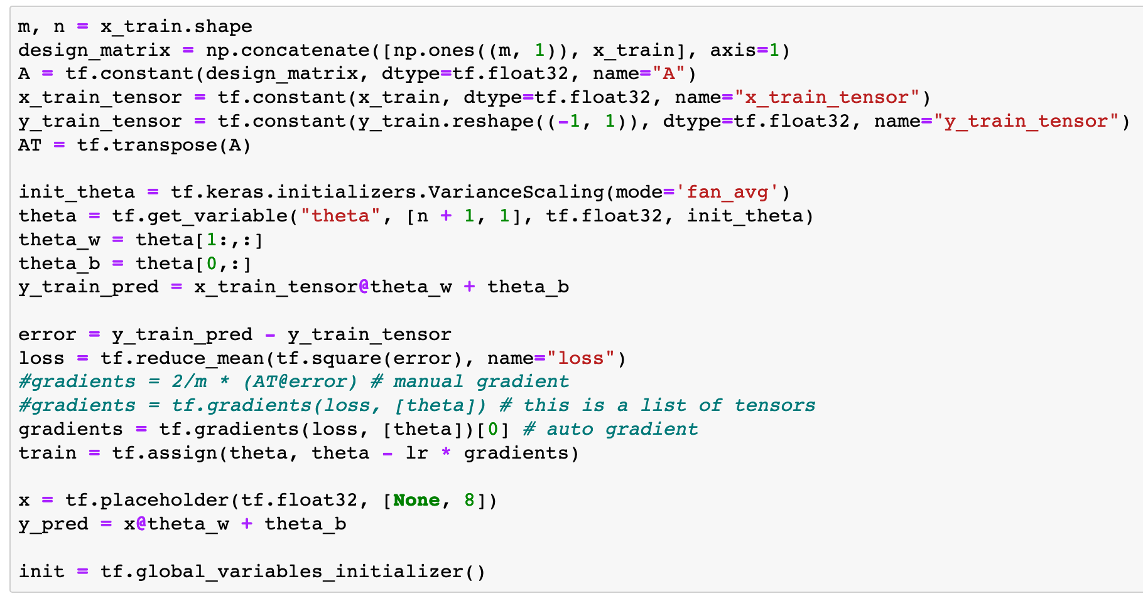

Slide 14
Session

Slide 15
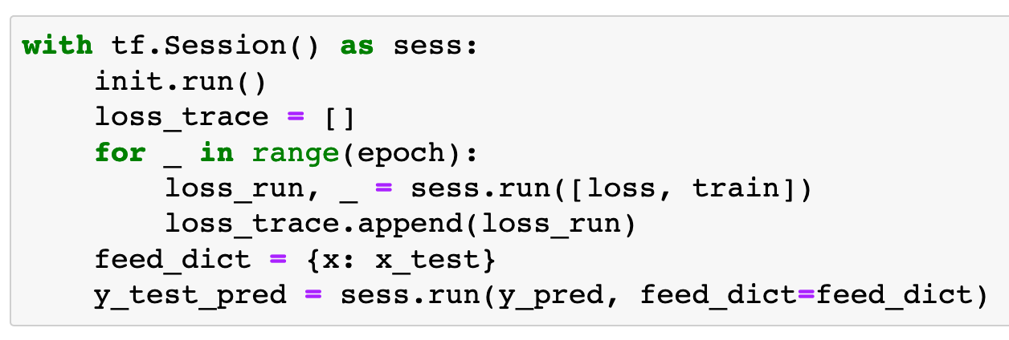

Slide 16
Report

Slide 17
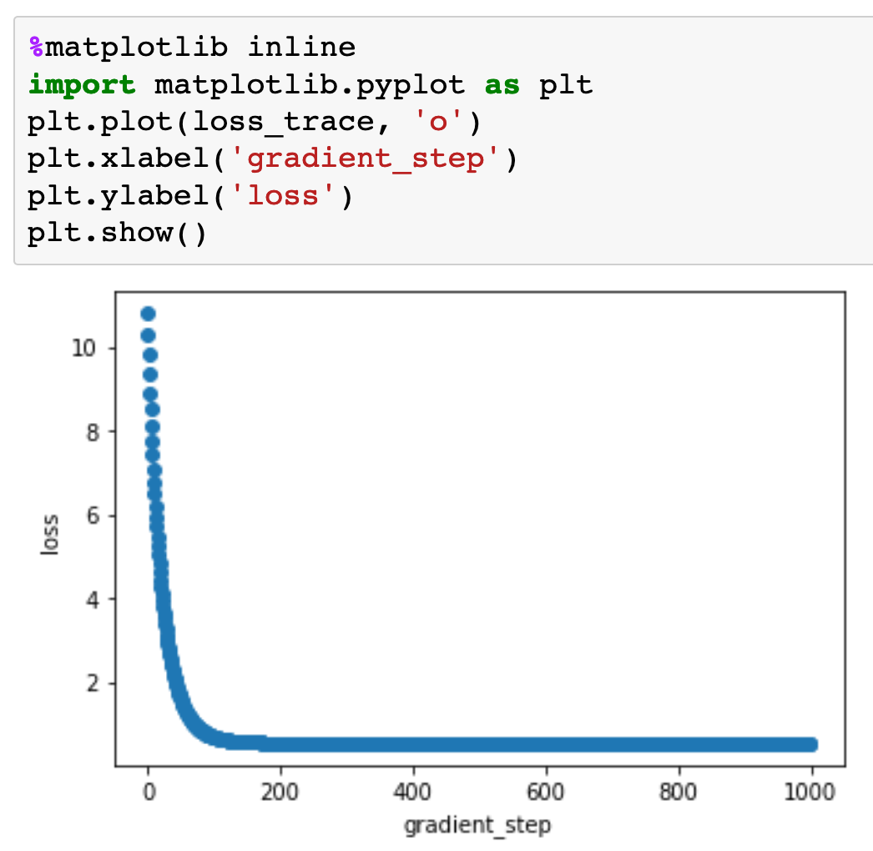

Slide 18
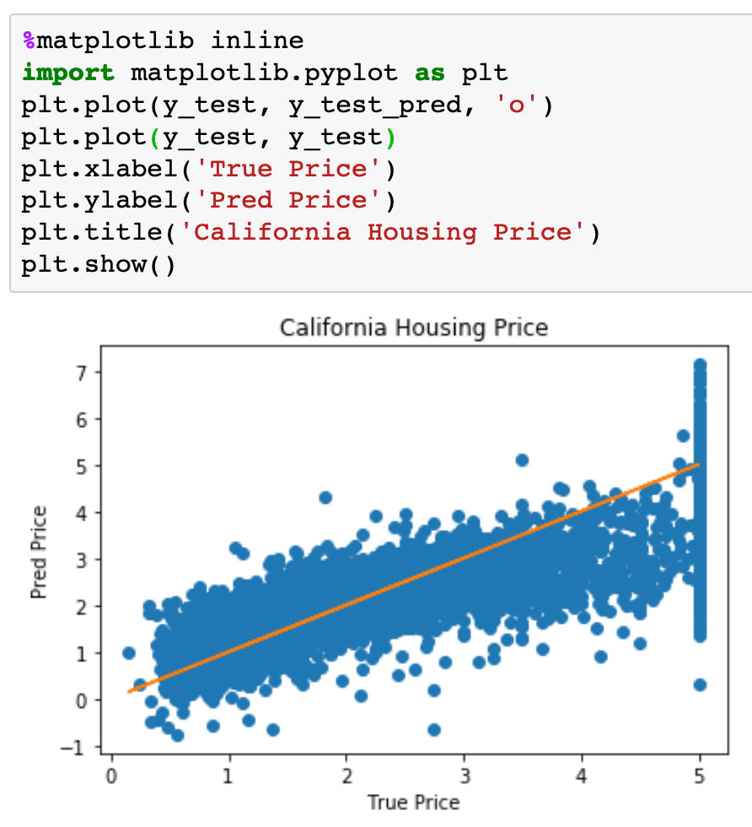

Slide 19
Now
Let’s Play with Code

